Slide 1
Chapter 2: Operating-System Structures

Slide 2
Operating System Services
Operating systems provide an environment for execution of programs and services to programs and users
One set of operating-system services provides functions that are helpful to the user:
  User interface - Almost all operating systems have a user interface (UI).
    Varies between Command-Line (CLI), Graphics User Interface (GUI), Batch
  Program execution - The system must be able to load a program into memory and to run that program, end execution, either normally or abnormally (indicating error)
  I/O operations - A running program may require I/O, which may involve a file or an I/O device

Slide 3
Operating System Services (Cont.)
One set of operating-system services provides functions that are helpful to the user (Cont.):
  File-system manipulation - The file system is of particular interest. Programs need to read and write files and directories, create and delete them, search them, list file Information, permission management.
  Communications – Processes may exchange information, on the same computer or between computers over a network
    Communications may be via shared memory or through message passing (packets moved by the OS)
  Error detection – OS needs to be constantly aware of possible errors
    For any error, OS should take appropriate action to ensure correct and consistent computing
    Debugging facilities can greatly enhance the user’s and programmer’s abilities to efficiently use the system

Slide 4
Operating System Services (Cont.)
Another set of OS functions exists for ensuring efficient operation of the system itself via resource sharing
  Resource allocation - When multiple users and multiple jobs are running concurrently, resources must be allocated to each of them
    Resources - CPU cycles, main memory, file storage, I/O devices.
  Accounting - To keep track of which users use how much and what kinds of computer resources
  Protection and security -
    Protection involves ensuring that access to system resources is controlled
    Security of the system requires user authentication, extends to defending external I/O devices from invalid access attempts

Slide 5

A View of Operating System Services

Slide 6
User Operating System Interface - CLI
CLI or command interpreter allows direct command entry
  Sometimes implemented in kernel, sometimes by systems program
  Sometimes multiple flavors implemented – shells
  Primarily fetches a command from user and executes it
  Sometimes commands built-in, sometimes just names of programs
    If the latter, adding new features doesn’t require shell modification

Slide 7

Bourne Shell Command Interpreter

Slide 8
System Calls
Programming interface to the services provided by the OS
Typically written in a high-level language (C or C++)
Mostly accessed by programs via a high-level Application Programming Interface (API) rather than direct system call use
Three most common APIs are Win32 API for Windows, POSIX API for POSIX-based systems (including virtually all versions of UNIX, Linux, and Mac OS X), and Java API for the Java virtual machine (JVM)

Slide 9

Example of System Calls
System call sequence to copy the contents of one file to another file

Slide 10
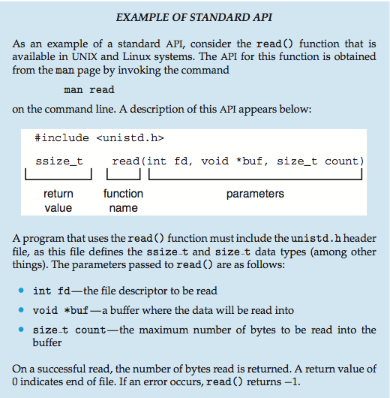
Example of Standard API

Slide 11
System Call Implementation
Typically, a number associated with each system call
  System-call interface maintains a table indexed according to these numbers
The system call interface invokes the intended system call in OS kernel and returns status of the system call and any return values
The caller need know nothing about how the system call is implemented
  Most details of OS interface hidden from programmer by API
    Managed by run-time support library (set of functions built into libraries included with compiler)

Slide 12

API – System Call – OS Relationship

Slide 13
Types of System Calls
Process control
  create process, terminate process
  end, abort
  load, execute
  get process attributes, set process attributes
  wait for time
  wait event, signal event
  allocate and free memory
  Dump memory if error
  Debugger for determining bugs, single step execution
  Locks for managing access to shared data between processes

Slide 14
Types of System Calls
File management
  create file, delete file
  open, close file
  read, write, reposition
  get and set file attributes
Device management
  request device, release device
  read, write, reposition
  get device attributes, set device attributes
  logically attach or detach devices

Slide 15
Types of System Calls (Cont.)
Information maintenance
  get time or date, set time or date
  get system data, set system data
  get and set process, file, or device attributes
Communications
  create, delete communication connection
  send, receive
  Shared-memory model create and gain access to memory regions
  transfer status information
  attach and detach remote devices

Slide 16
Types of System Calls (Cont.)
Protection
  Control access to resources
  Get and set permissions
  Allow and deny user access

Slide 17

Examples of Windows and Unix System Calls

Slide 18

Standard C Library Example
C program invoking printf() library call, which calls write() system call

Slide 19

Traditional UNIX System Structure

Slide 20

Microkernel System Structure

Slide 21
System Boot
When power initialized on system, execution starts at a fixed memory location
  Firmware ROM used to hold initial boot code
Operating system must be made available to hardware so hardware can start it
  Small piece of code – bootstrap loader, stored in ROM or EEPROM locates the kernel, loads it into memory, and starts it
  Sometimes two-step process where boot block at fixed location loaded by ROM code, which loads bootstrap loader from disk
Common bootstrap loader, GRUB, allows selection of kernel from multiple disks, versions, kernel options
Kernel loads and system is then running

Slide 22
End of Chapter 2

